Slide 1

Communication Skills, Time Management & Interpersonal Skills
Present By:- SHALOMSHAN
Batch:- 08

Slide 2

Agenda
Time Management
Managing Time Efficiently
Time Management Skills
Communication Skills
Introduction to Interpersonal Skills
Importance of Interpersonal Skills
Communication in Interpersonal Skills
Tools in Interpersonal Skills
Verbal Communication
Non-Verbal Communication
Listening Skills
Negotiation
Problem Solving
Decession Making
Assertivenes
Conclusion

Slide 3

Time Management
Time management is more than just managing time
Controlling the use of the most valuable and undervalued resource
Managing oneself in relation to time
Setting priorities & talking charge of the situation & time utilization
Changing those habits or activities that cause waste of time
Willing to adopt habit & methods to make maximum use of time

Slide 4

Managing Time Efficiently
Urgent task
Urgent tasks demand your immediate attention, but whether you
actually, give them that attention may or may not matter.
Important tasks
'Important' tasks matter, and not doing hem may have serious
consequences for you or others.

Slide 5
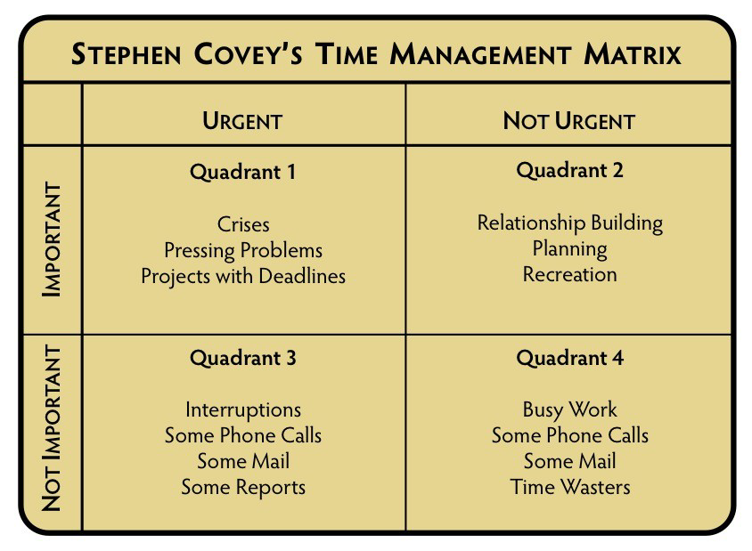

Slide 6

Time Management Skills
Goal Setting
Prioritization
Self-awareness
Focus
Self - motivation
Planning
Communication Skills
Delegation/outsourcing
Stress Management
Patience

Slide 7
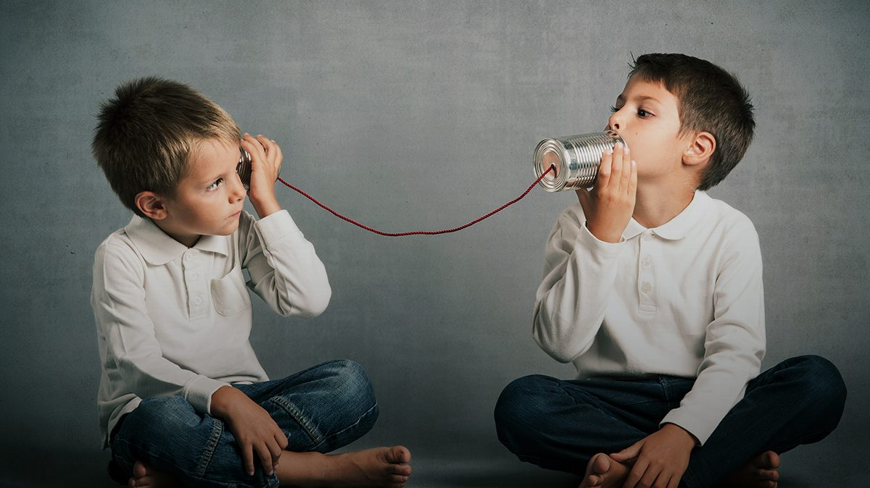
Communication Skills
Have to work with others on a daily basis.
Strong communication skills will enable us to build supportive
relationships with those whom we work with.
When we require another person to do some work for us; we
wants to communicate in a manner which will enable them to
perform the work to the desired standard, in the fastest time.
If any errors occur, we will want to raise the issue quickly and
explain clearly about the adjustments that need to be made.
Quality of your communication directly impacts the quality of
the work that gets done.

Slide 8

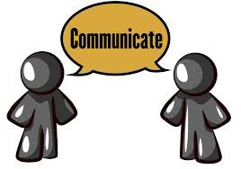
Introduction to Interpersonal Skill
Interpersonal skills are the attitudes and habits that make workers at any seniority level valuable employees and contributing members of the work environment.
Interpersonal skills comes from the root word Interaction & Person. In other words, it is the communication among two or more persons.
They include communication and social skills, teamwork, problem solving and critical thinking, and professionalism (time management and appearance).

Slide 9

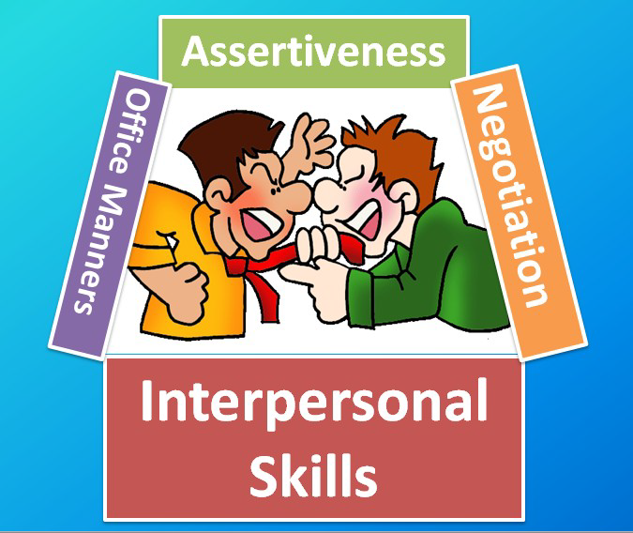
Importance's of Interpersonal Skills
Employers will notice the presence or absence of these skills immediately during an interview, and they can impact long term advancement opportunities.
These skills are also important outside of the work life skills training can be “critical in enhancing the self-esteem of participants, Importance of Interpersonal Skills providing them the tools necessary to overcome their fear of independence and allowing them to experience their own definition of success”

Slide 10


Communication in Interpersonal Skills
Words are powerful tools of communication. Indeed, word choice can easily influence the thoughts, attitudes, and behavior of the people listening to us. Communication in Interpersonal Skills.
Similarly, proper attention to the language of others can give us insight to what it is that they are really saying, helping us to respond appropriately and effectively.

Slide 11

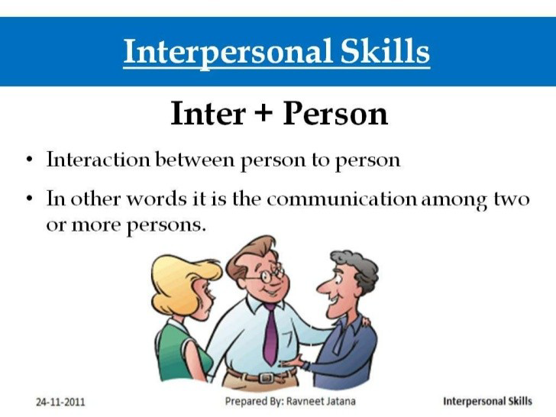
Tools in Interpersonal Skills
Interpersonal skills are the tools people use to interact and communicate with individuals in an organizational environment. There are seven main areas of interpersonal communication.
The seven areas are:
•Verbal communication
•Non-verbal communication
•Listening skills
•Negotiation
•Problem-solving
•Decision-making
•Assertiveness

Slide 12


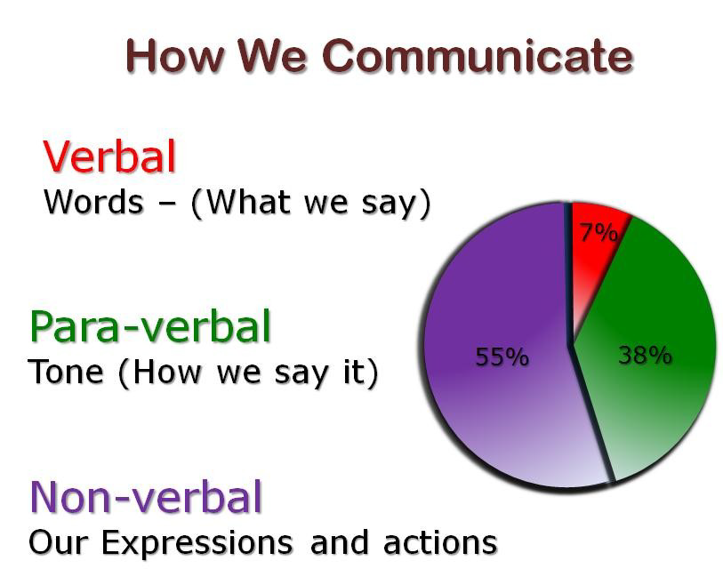
Verbal Communication
Verbal communication is how and what words are used to communicate with individuals. It is the ability to communicate through words with the correct tone and manner. Tools in Interpersonal Skills
Fred's initial week with Intestinal Distress Taco revealed that he was not capable of good verbal communication. He mumbled orders and then screamed when employees did anything wrong.
Most employees grew to dread working with Fred because they could not understand his directions. He also was not a good non-verbal communicator as well.

Slide 13

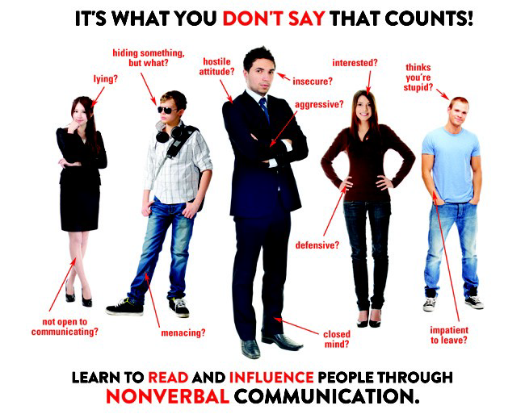
Non-Verbal Communication
Another type of interpersonal skill is non-verbal communication, which consists of facial expressions, body language and hand gestures.
Non-Verbal Communication can be Positive as well as Negative.
Negative Non-Verbal Communication consisted of frowns and angry stares.

Slide 14

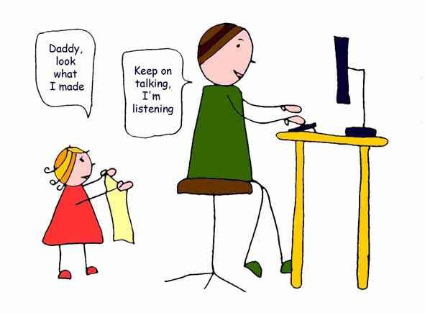
Listening Skills
The ability to hear attentively and process information correctly.
A very ineffective listener do not pay attention when they are told. They have the tendency to ignore important
pieces of other’s communication.

Slide 15

Negotiation
Negotiation is the next type of interpersonal skill that is important to effective business communication. This term means having the ability to discuss and reach an agreement in a professional manner.
Example: Violet excels in negotiation as the employees and customers are always complaining or asking for favors. She is good at listening and discussing situations and then coming up with a fair solution.
On the other hand, Fred ignores any request for discussions and rules with an iron fist. This has caused his employees to view him as unfair and undiplomatic, especially when it comes to solving problems.

Slide 16


Problem Solving
The fifth type of interpersonal skill is problem-solving. This is a very important skill and the most complex part of the process is to look at each potential solution and carefully analyze it.
The ability to find a solution to a problem after considerable thought to solved numerous issues without creating a new problem

Slide 17

Decesion Making
This is the most complex part of the problem solving that requires careful analysis of the outcome of actions and then selecting the best solution for implementation. It requires simulating each potential solution carefully.
We all have to make decisions all the time, from issues like what to have for lunch, right up to lifechanging decisions like where and what to study, and who to marry.
Some people put off making decisions by endlessly searching for more information or getting other people to offer their recommendations. Others resort to decision-making by taking a vote, sticking a pin in a list or tossing a coin.

Slide 18
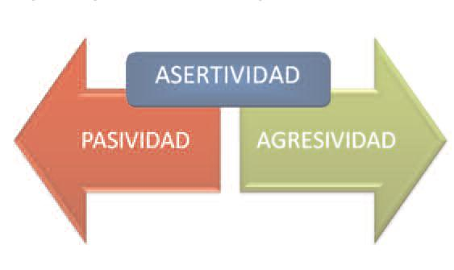
Assertiveness
is about being able to express yourself with confidence, without having to resort to passive, aggressive or manipulative behavior
It involves greater self-awareness; getting to know, like, and be in charge of the real ‘you’.

Slide 19


Slide 20


